Slide 1

अन्नदाता:A Farmer’s Portal
Group No:14
Swarad Hajarnis : 18104073
Shubham Khairnar : 18104025
Kaustubh Sawant : 18104066
Guided by
Dr. Sameer Nanivadekar
Prof. Vidya Shet

Slide 2
Contents
Introduction
Litrature Review
Objectives
Scope
Technology Stack
Block Diagram to propose project idea.
References

Slide 3
1. Introduction
Problem Identified :
    In today’s world along with ongoing pandemic crises farmer has been facing a lot of issues.
    Some of which identified are:- Cope with climate change, biodiversity loss, soil erosion, market prices of crops etc.
    Staying resilient against the global economic factor becomes a task for them.
    All-in-all there are various sector in which farmer has been facing issues since ages.

Slide 4
1. Introduction
Solution Proposed :
Addressing the above mentioned issues the , project is designed with an aspect to help farmer in various sectors, Here in, we would be designing a web app that will analyse all the above mentioned conditions and provide them the analysis in simpler and there native language. Till now we have completed below mentioned modules and provided a multi-lingual support to the website.
Modules:
Current Weather Conditions.
Government Schemes
Farm Bills
Soil and Water Conservation
Farmer Corner
Equipment Shops

Slide 5
2. Litrature Review
Sr. No. | Authors | Paper Tittle | Methodologies | Findings
1 | Kiran Moraye, Arun Pathvte, Suyog Nikam | Crop Yield Production Using Random Forest Algorithm for Major Cities in Maharashtra | Prediction of the crop yield using Random Forest Algorithm | This Algorithm considers the geographic conditions and generate the list of the crops that could be the best practise in that region.
2 | Kanakamedala Deepika, Veeranki Tilekya, Jatroth Mamatha, Subetha T | Jollity Chatbot- A contextual AI Assistant | This Chatbot suggest people with articles,videos and images.Providing instant replay when people want to talk to someone during their tough times.To engage the users with some fun videos and s ongs. | We would be considering this and the technology used behind Jollity Chatbot and modify and upgrade to create our own chatbot for farmers.

Slide 6
3. Objectives
To develop an chatbot to solve the queries of the farmers.
To enable Indic language on the conversation system using Google Translate API.
To provide a multi-lingual support to the portal.
To notify the farmers about the red flags in weather forecasting.
To make them aware about the different Govt. Schemes that are beneficial to them and notify them everytime the government launches a new scheme.

Slide 7
4. Scope
Can help the farmers by enabling weather prediction system .
Can provide the farmers with legitimate information about the government schemes.
A prediction system that would help farmers about the best yielding practices.
Can enable the farmers to post their queries with the help of chatbot.

Slide 8
5. Technology Stack
Python
Django
Database: SQLite3

Slide 9
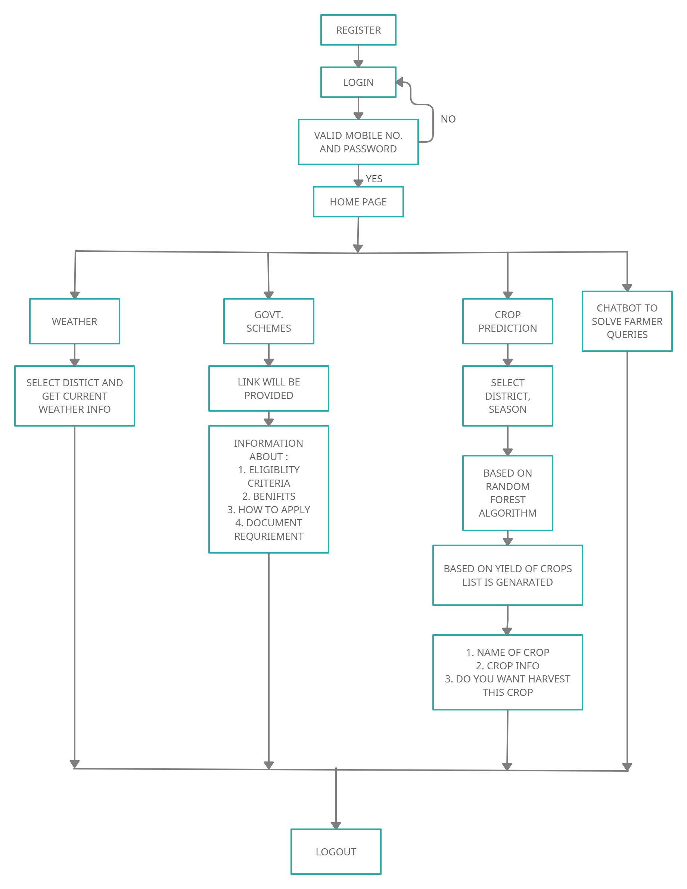
6. Block Diagram to propose project Idea

Slide 10
8. References
Kiran Moraye, Aruna Pavate, Suyog Nikam and Smit Thakkar,” Crop Yield Production Using Random Forest Algorithm for Major Cities in Maharashtra”, International Journal of Innovative Research in Computer Science & Technology (IJIRCST), March 2021.
Link to pdf
Kanakamedala Deepika, Veeranki Tilekya, Jatroth Mamatha, Subetha T,” Jollity Chatbot- A contextual AI Assistant’,IEEE,November 2020.
Prof. Yashaswini. D. K, Hemalatha. R, Niveditha. G,” Smart Chatbot for Agriculture”,
International Journal of Engineering Science and Computing, May 2019
Link to pdf
Note: Papers must be Recent one after 2018 papers preferred

Slide 11
Thank You...!!

